Slide 1

Going further with Github
@JONATHANMEDD
@PSSouthampton

Slide 2
Background
Chris Murray has carried out two sessions for us previously on GitHub
Looked at:
Creating repositories
Committing code to the repository
Working with issues
Pull requests
Using the GitHub client for Windows

Slide 3
Agenda
1) Using VS Code with GitHub
2) GitHub Reviews / Labels / Releases / Milestones
3) A brief intro to using Azure DevOps (formerly VSTS) to help with Builds and Releases

Slide 4
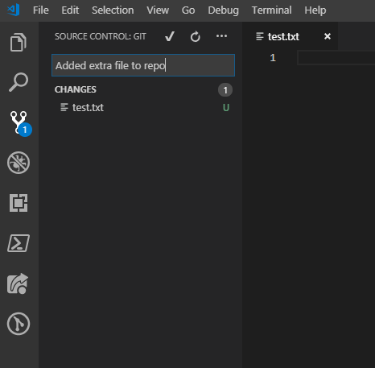
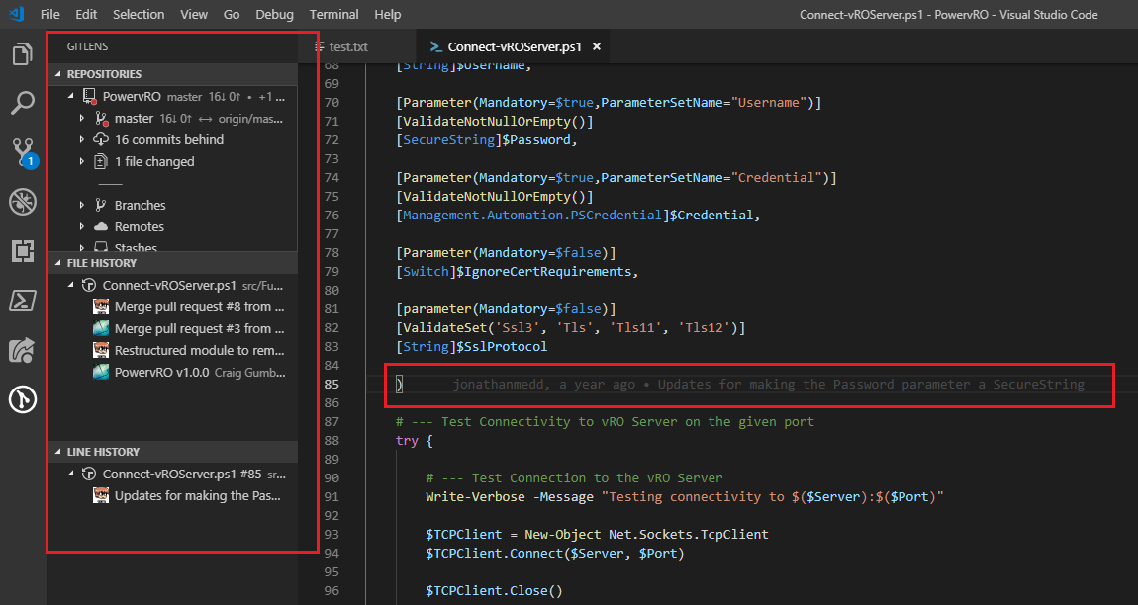
Using VS Code with GitHub
VS Code has Source Control Integration built into the client
Install Git on your system in order to be able to work with a repository like GitHub
Enhance the integration with an extension such as GitLens

Slide 5
Using VS Code with GitHub
Demo

Slide 6
GitHub Reviews / LABELS / Releases / Milestones
When working with other developers on a shared project or taking contributions from others on your own project, it can be useful to make use of additional features in GitHub
Reviews – provide feedback on pull requests
Labels – organise issues and pull requests
Releases – distribute your software via a release
Tip: Use Semantic Versioning to define your release numbering
Milestones – track which issues and pull requests will be targeted for completion against which release

Slide 7
GitHub Reviews / Labels / Milestones / Releases
Demo

Slide 8
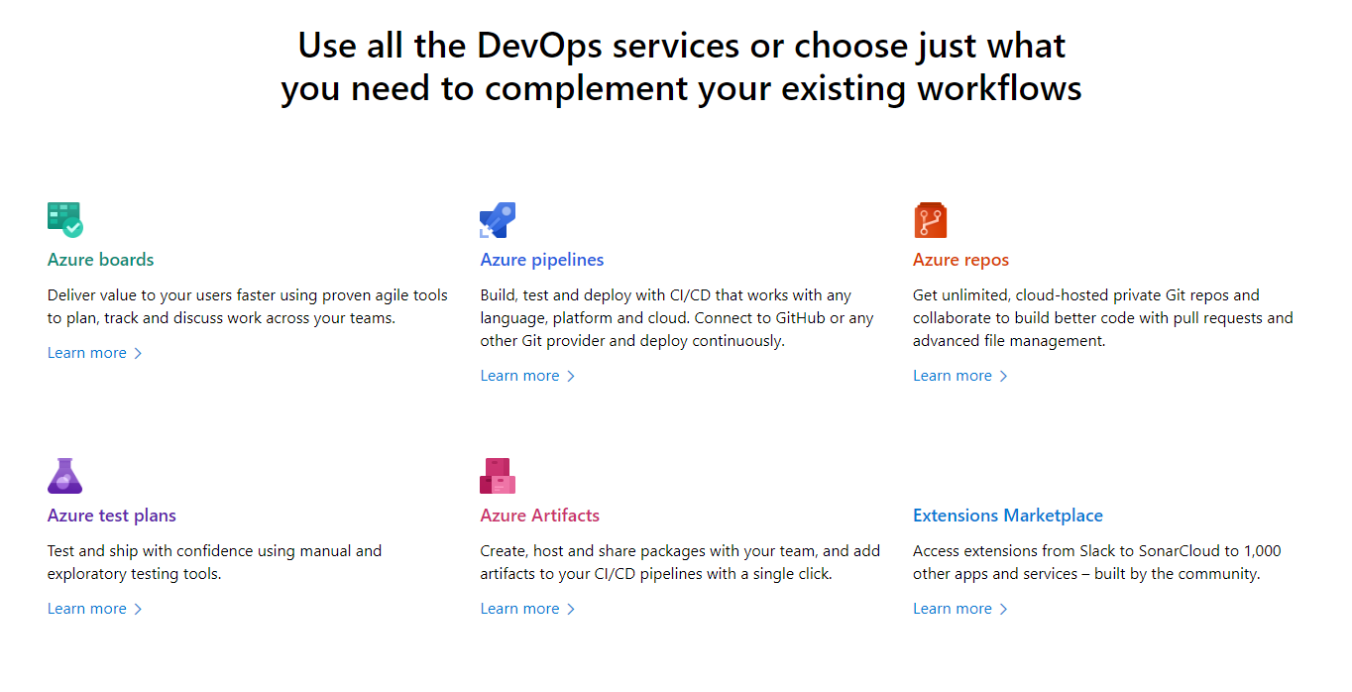
Azure DevOps (formerly VSTS)

Slide 9
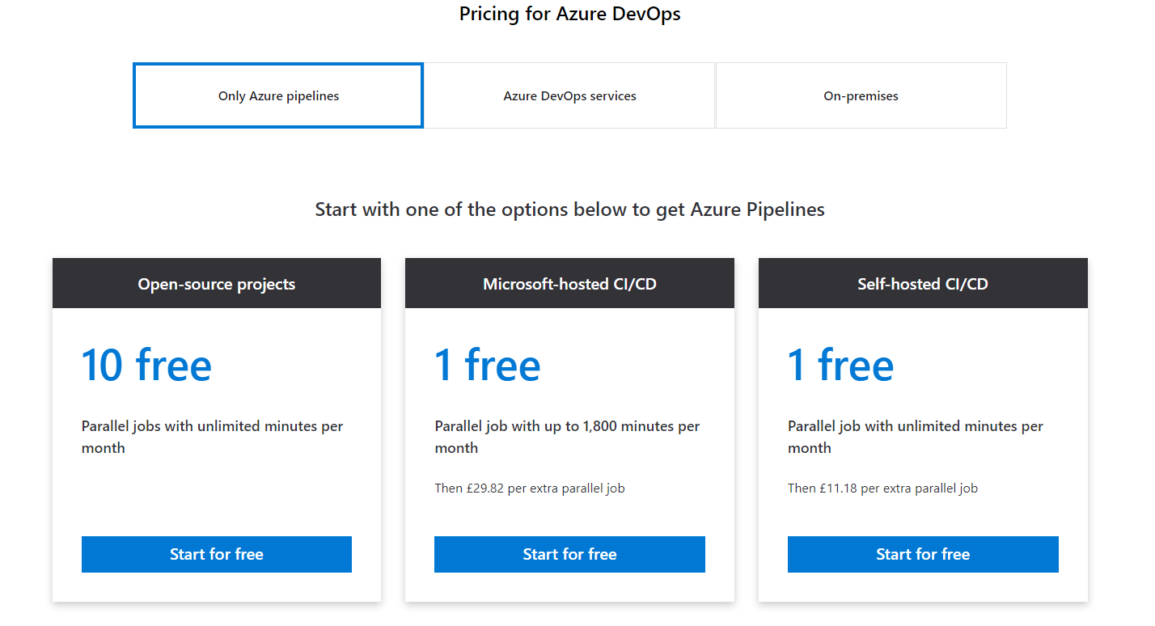
Azure DevOps (formerly VSTS)

Slide 10
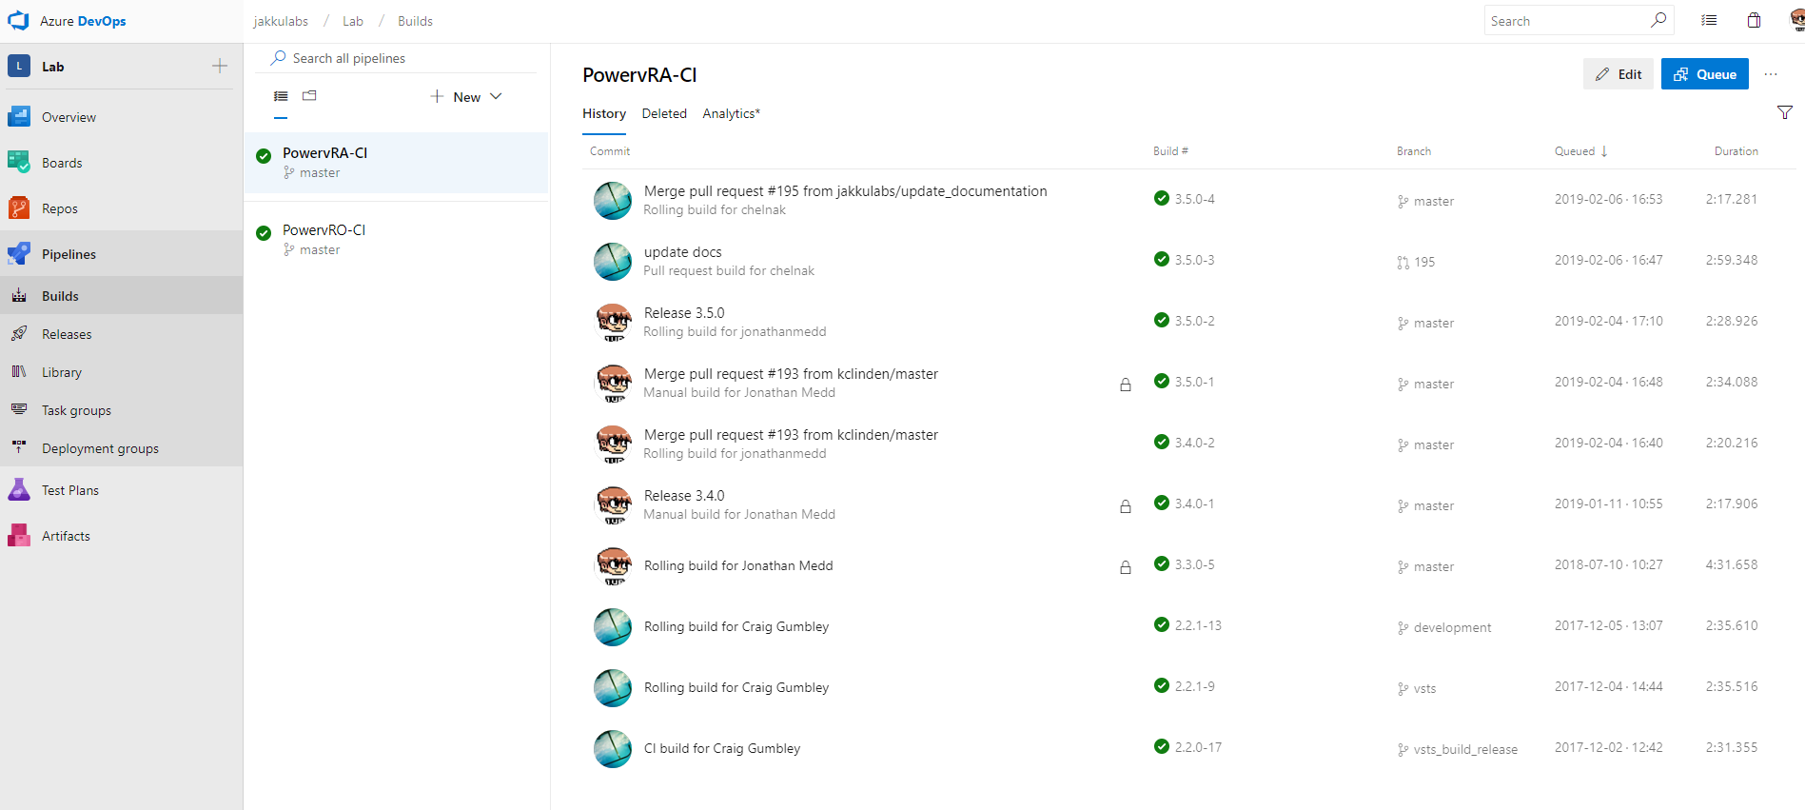
Azure DevOps - Pipelines

Slide 11
Azure DevOps - Pipelines
Demo

Slide 12
The ENd

